Slide 1
Title
Unemployment
Consumer Finance
DataFest 2023 - American Bar Association Data
Allocating Attorneys using key economic indicators
ALLOCATING
ATTORNEYS
Shreyank Kadadi, Nishaanth Krishnan, Milla Nielsen, Damien Ha
National Student Data Corps - NSDC

Slide 2
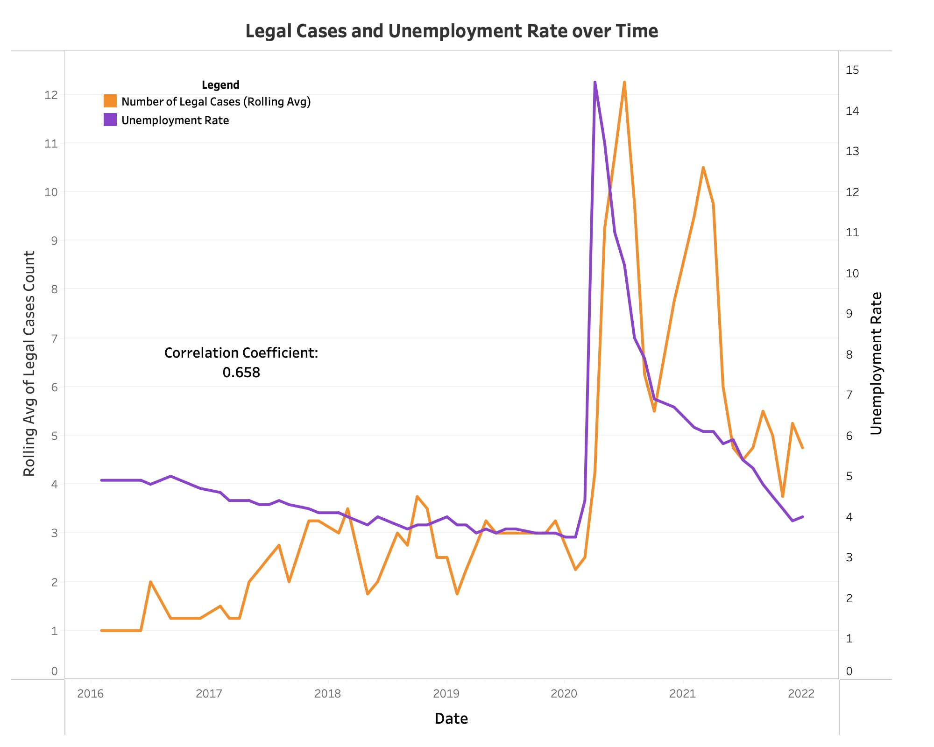
Title
Unemployment
Consumer Finance
DataFest 2023 - American Bar Association Data

Slide 3
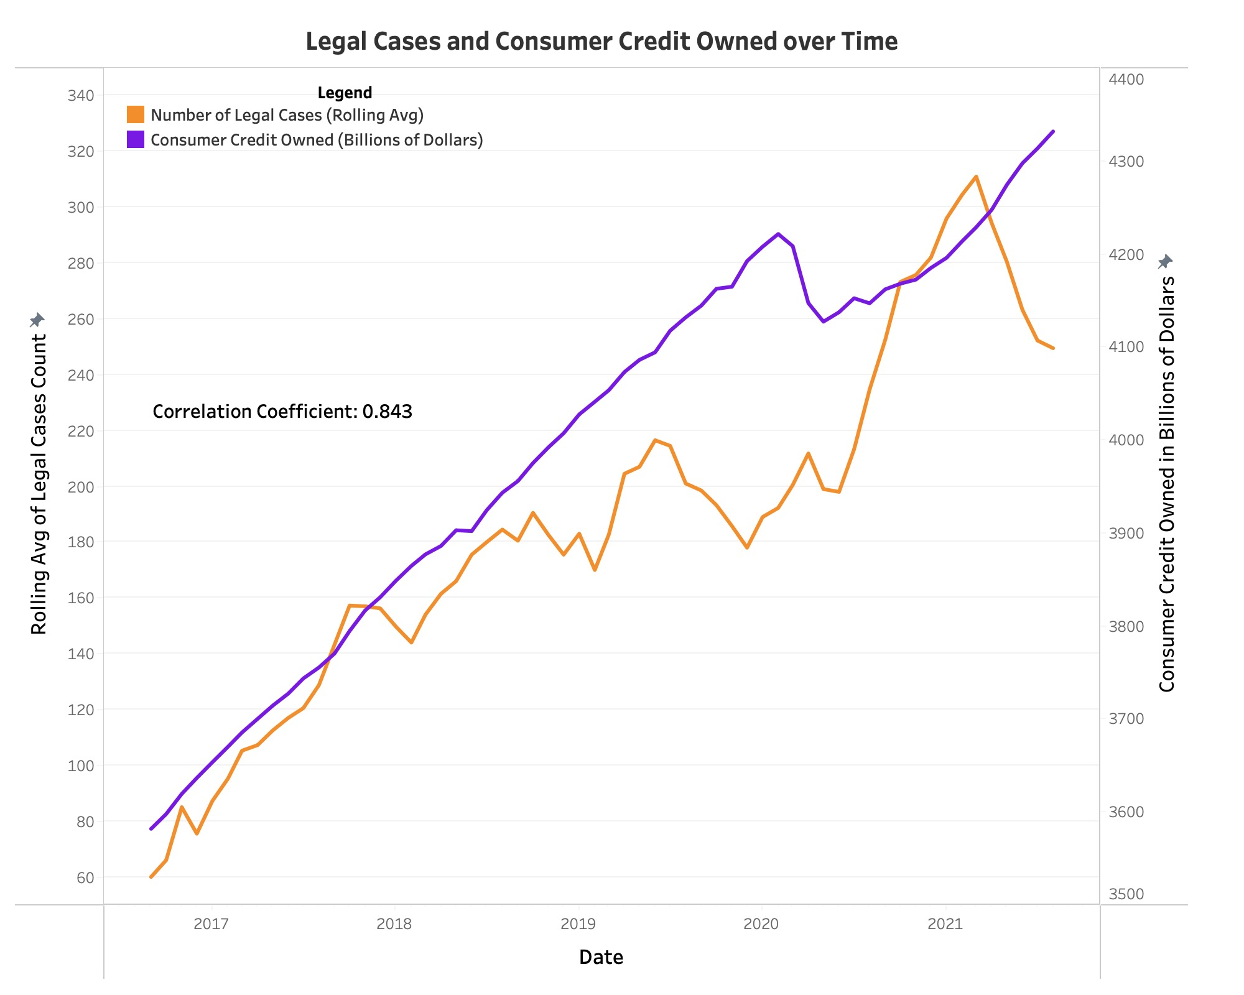
Title
Unemployment
Consumer Finance
DataFest 2023 - American Bar Association Data
Consumer Finance Conversations
Latent Dirichlet Allocation
“Bankruptcy”
“Debt”

